Slide 1

Environmental and Socio-Economic Impact of COVID-19
Case Study: Carbon Emission and GDP per Capita
Data Science and Machine Learning Bootcamp.

Slide 2


PRESENTATION
By:
DEBORAH A. ADEDIGBA
Data Analyst

Slide 3
ABSTRACT
INTRODUCTION
CODE IMPLEMENTATION
CONTENTS
DATA VISUALIZTION
MACHINCE LREANING : MODELLING
RESULTS & CONCULSION

Slide 4
ABSTRACT

Slide 5
ABSTRACT
The aim of this study is to identify the effects that COVID-19 has on the environment (Carbon Emission) and the global economy (GDP per capita).
The Datasets on COVID-19, Carbon Emission (CO2), and GDP per capita were collected from WHO, European Union, and World Development Indicator respectively.
The analysis aspect of this study is going to be conducted with the use of Python for data cleaning, data normalization, data analysis, Tableau for data visualization, and PowerPoint/Jupyter for the presentation of results.
This study reveals several major countries with intensive carbon emissions-related operations and imposed lockdown measures for extended periods significantly reduced carbon emissions in 2020 compared to pre-COVID periods. By contrast, several major countries are either slightly impacted by COVID-19 or not
65
Enter title
3
Enter title

Slide 6
INTRODUCTION

Slide 7
INTRODUCTION
The world suddenly experienced a perilous reality on the 11th of March, 2020 when the World Health Organization (WHO) declared the novel corona-virus (COVID-19) a pandemic originating from Wuhan, China. Cases rapidly spread to other countries such as Japan, South Korea, Europe, the United States, and later the entire world. The negative and postive effects have ranged from a severe contraction of GDP in many countries to multi-dimensional environmental and social issues across the strata of society.
%

Slide 8








Environmental and Socio-Economic impact of COVID-19. Case Study: Using Carbon Emission and GDP per capital Project Process Flow
DATACLEANING / MOD ELING
& A NALYSIS
Data Cleaning: Using Python, we cleaned the data that can skew the result of the analysis, so has to have an increased overall productivity of our analysis and result
Data Modelling: Choosing a favorable model (Linear Regression) to enhance achievement of
PLANNING STAGE
Introduction: We came together getting to know each Collection other strength and skill .
Topic Deliberation: Discussions on possible problems we
could proffer solutions to and suitable topics for such .
Research (Literature Review): Reading and
understanding the impact of our project on the world
and getting an in-depth knowledge of it.
3
4
Data
Data Analysis: Utilizing the model we derived above to analyse and predict a conclusion about the initial questions of the project
Data Cleaning
1
5
Planning
2
Data Collection
Data Modeling / Analysis
6
DATA COLLECTION
We proceeded to collect data from three
sources: W HO, EU and World Development
Indicator
Data Sourcing
Recommendations/ Conclusion
DATA SOURCING
After our research we agreed on the datasets to use for the project which are COVID-19, Carbon Emission and GDP per capita Data.

Slide 9
CODE
IMPLEMENTATION

Slide 10
Code implementation
ANALYTICAL TOOLS
JUPYTER LAB
TABLEAU
MACHINCE LREANING TOOL
EXPLORATORY DATA ANALYSIS
MINMAX SCALER
LINEAR REGRESION
ACCURACY SCORE
CROSS VALIDATION
CLEANING OF DATA
Filling missing values
Converting date to DateTime format
Converting daily to yearly data
Sorting alphabetically
Covering columns to rows
A
M
LIBRARIES
import numpy as np
import pandas as pd
import datetime as dt
import matplotlib as plt
import seaborn as sns
L
L
LIBRARIES import StandardScaler import train_test_split
import LinearRegression
import accuracy_score
import r2_score
import cross_val_score

Slide 11
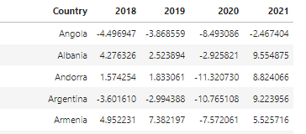

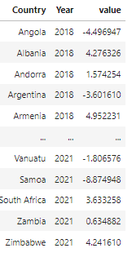
CODE SAMPLES: COVERTING COLUMNS TO ROWS
FROM
THROUGH
TO

Slide 12
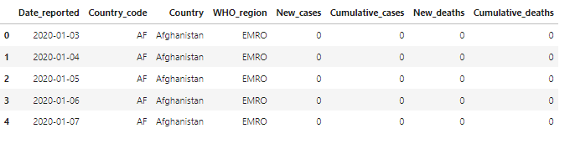
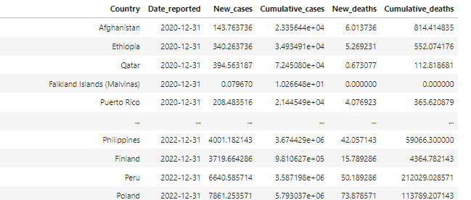
CODE SAMPLES: COVERTING DAILY TO YEARLY DATA
FROM
THROUGH
TO
Notes:
#converting the data from daily to yearly data
covid_clean_data = covid_data.groupby("Country").resample('Y', label='right', closed = 'right', on='Date_reported').mean().reset_index().sort_values(by='Date_reported')
covid_clean_data

Slide 13
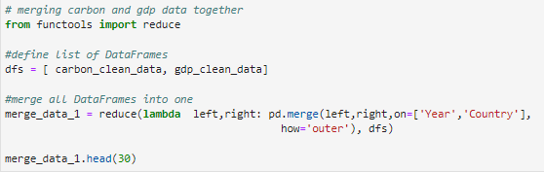
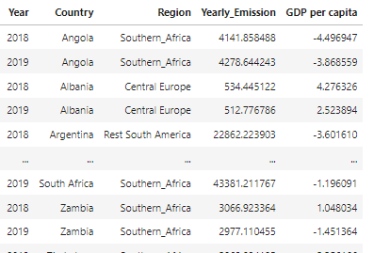
CODE SAMPLES: MERGING OF TWO DIFFERNT DATA FRAMES
FROM
TO

Slide 14
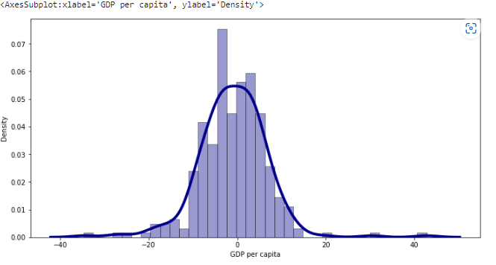

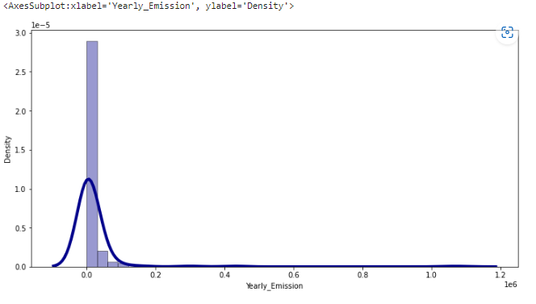

CODE SAMPLES: HISTOGRAM OF THE TARGET VARIABLES

Slide 15
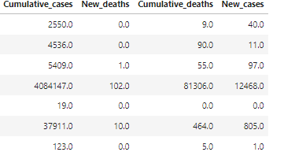

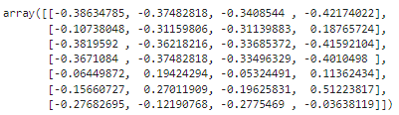
CODE SAMPLES: RETURNING THE SCALER OF THE TRAINING DATA
FROM
THROUGH
TO

Slide 16

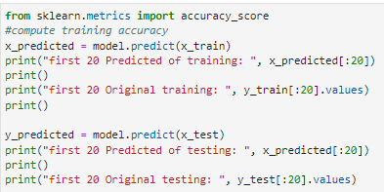
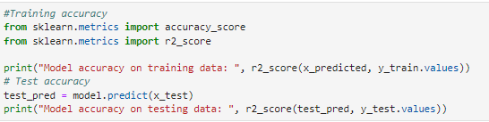
CODE SAMPLES: LINEAR REGRESSION MODEL
THROUGH
TO
TO
TO

Slide 17
DATA VISULIZATIONS

Slide 18
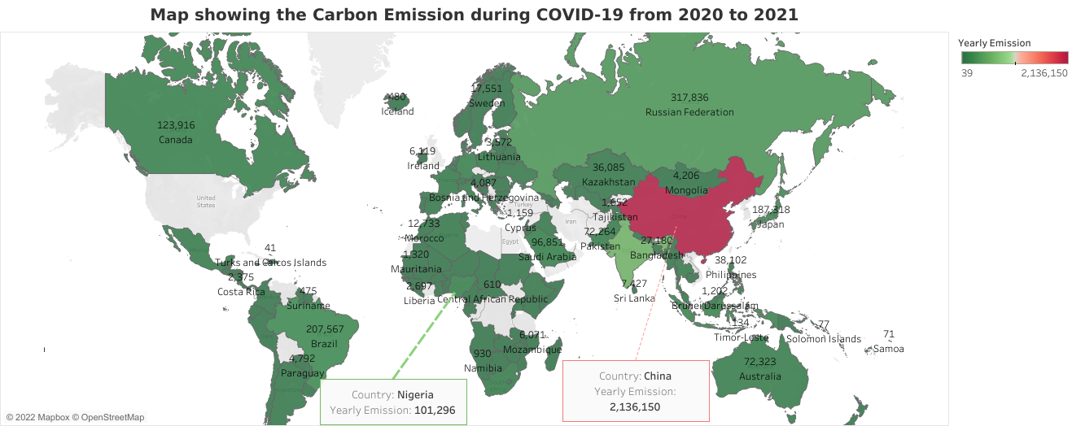
Visualization: Carbon Emission map for 2020 -2021
China Had a GDP per capita of 2,136,150,but a 2,040,606 before COVID-19
.
Lebanon Had a GDP per capita of 4,361,but a 4,727 before COVID-19
India
Had a GDP per capita of 600,103,but a 610,110 before COVID-19
Nigeria Had a GDP per capita of 101,296,but a 99,258 before COVID-19
.
Dominica
Had a GDP per capita of 39,but a 44 before COVID-19

Slide 19
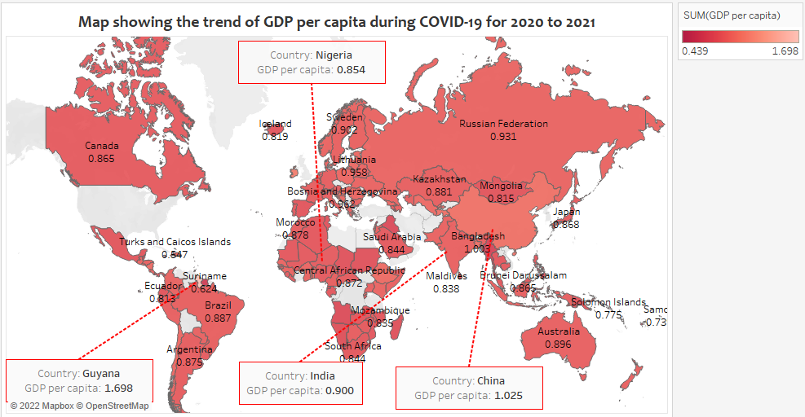
Visualization: GDP per capita map for
2020 -2021
China Had a GDP per capita of 10,but a 12 before COVID-19
Lebanon Had a GDP per capita of -35,but a -9 before COVID-19
India Had a GDP per capita of 0,but a 8 before COVID-19
Nigeria Had a GDP per capita of -3,but a -1 before COVID-19
Dominica
Had a GDP per capita of -11,but a 9 before COVID-19

Slide 20
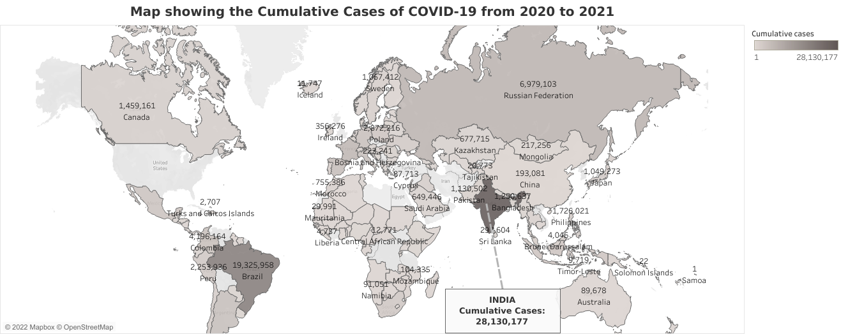
Visualization: COVID-19 Cumulative Cases map for 2020 -2021
China Had a Total of 193,081 cases.
Lebanon Had a Total of 556,248 cases.
India Had a Total of 28,130,177 cases.
Nigeria Had a Total of 206,367 cases.
Dominica
Had a Total of 1,718 cases.

Slide 21
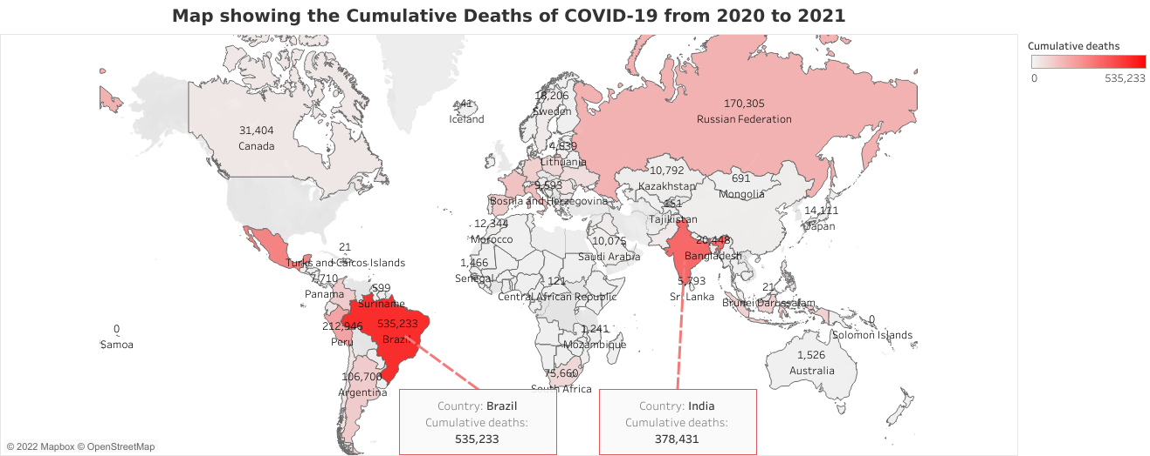
Visualization:COVID-19 Cumulative Deaths map for 2020 -2021
China Had a Total of 9,186 deaths.
Lebanon Had a Total of 7,219 deaths.
India Had a Total of 378,431 deaths.
Nigeria Had a Total of 2,844 deaths.
Dominica
Had a Total of 9 deaths.

Slide 22
MACHINCE LEARNING:MODEL

Slide 23
CORRELATION OF THE MODEL VARIABLES
 | New_cases | Cumulative_cases | New_deaths | Cumulative_deaths | Yearly_Emission | GDP per capita
New_cases | 1 | 0.949089 | 0.880424 | 0.832908 | 0.256536 | 0.127847
Cumulative_cases | 0.949089 | 1 | 0.842735 | 0.885247 | 0.218011 | 0.17279
New_deaths | 0.880424 | 0.842735 | 1 | 0.919167 | 0.222631 | 0.090663
Cumulative_deaths | 0.832908 | 0.885247 | 0.919167 | 1 | 0.180789 | 0.1743
Yearly_Emission | 0.256536 | 0.218011 | 0.222631 | 0.180789 | 1 | 0.072274
GDP per capita | 0.127847 | 0.17279 | 0.090663 | 0.1743 | 0.072274 | 1
From the table:
There exist a correlation between the COVID-19 features
Little correlation between Yearly_Emission(CO2) and COVID-19 features
Little correlation between GDP per capita and COVID-19 features
Very little or No correlation between Yearly_Emission and GDP per capita

Slide 24
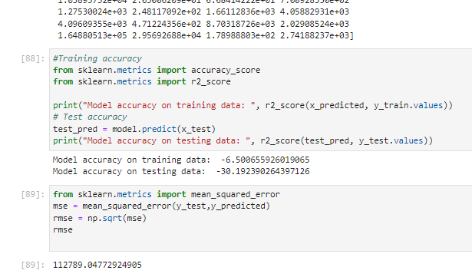
LINEAR REGRESSION
In our regression analysis, where we tried to predict the target variables Carbon Emission and GDP per capita. The Training and Test Accuracy scores were negative after we used the MinMax Scaler to nornmalize our data after spliting the data.
A negative accuracy score shows our data is not sufficient to help predict the required outcome
From the correlation we see there exist little relationship between our target and features
Suggestion of how to fix the data:
Addition of more data in terms of features that have better correlation with the target variables

Slide 25
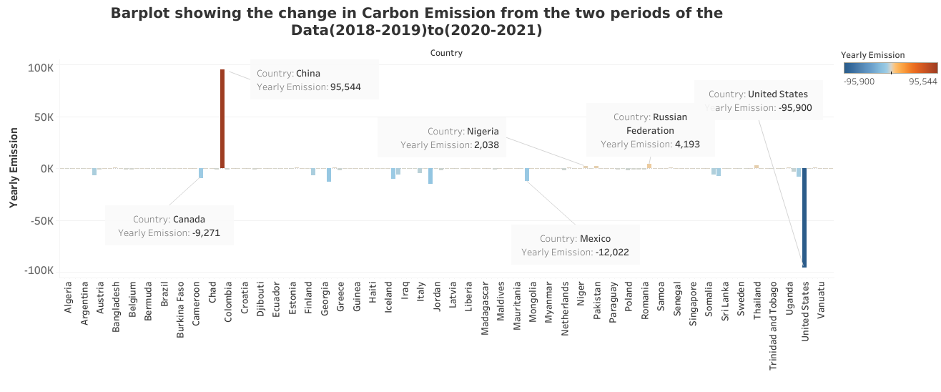
Barplot showing the change in Crabon Emission from the two periods Before and after COVID-19

Slide 26
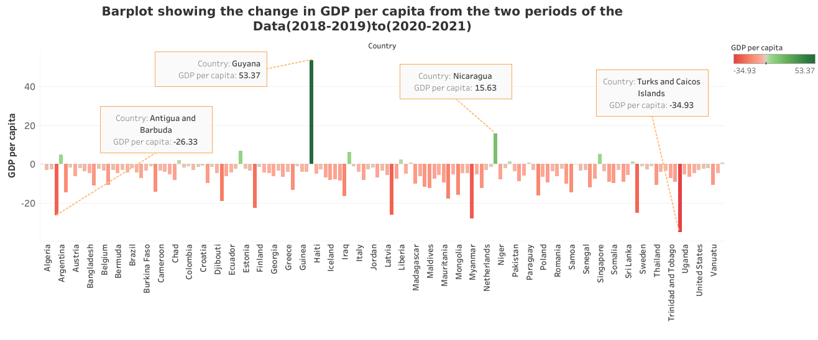
Barplot showing the change in GDP per capita from the two periods Before and after COVID-199

Slide 27
RESULT
&
CONCULSION

Slide 28
Results: GDP per capita
In 2018-2019, GDP per capital before COVID-19 showed:
Bangladesh in Asia recorded the highest combined GDP per capital in 2018 – 2019 with 12.97
Ireland in Europe was 11.18 while Dominican Republic in America was 9.79
Congo Republic had the least GDP in Africa with -9.85 while Northern Mariana Islands in America was -31.47
Nigeria’s combined GDP per capital depressed to -1.06 while Lebanon in Asia was -9.32
Also in 2020-2021, GDP per capital during COVID-19 showed a combined value for:
Bangladesh has 8.32
Ireland has 17.30
Lebanon has -35.35,been the lowest
Nigeria has -3.19
Dominican Republic has 3.53

Slide 29
Results:Carbon Emission
In 2018-2019, Carbon Emission before COVID-19 showed:
China in Asia recorded the highest combined carbon emission in 2018 – 2019 with 2,040,606
Ireland in Europe was 6,730 while Dominican Republic in America was 5,791
Dominica had the least carbon emission with 18.73
Nigeria’s combined carbon emission increased to 99,258 while Lebanon in Asia was 4727
Also in 2020-2021, Carbon Emission during COVID-19 showed a combined value for:
Bangladesh has 27,180
Ireland has 6,119
Lebanon has 4.361
Nigeria has 101,296
Dominican Republic has 5,710

Slide 30
conculsion
Carbon Emission
60% of all countries of the world had a reduction in their Carbon Emission during the COVID-19 period with some countries who having a little increase or a constant rate, and China have a high increase of Carbon Emission
GDP per capita
Here, majority(91%) of the countries exprienced a decrease in their GDP during the COVID-19 pandemic with the exception of a few countries such as Guyana,Nicaragua,Equatorial Guninea, Singapore, and others who during the COVID-19 have a rise in GDP per capita
Finally,from the analysis it is evident that COVID-19 had a great effect of reducing GDP per capita of most countries and also a reduction and increase of Carbon Emission due to the each countries activities.

Slide 31

Questions & answers

Slide 32
THANKS

